Slide 1
MacroHard
Alister Lawson
Bruce Fernandes
Jamie Mano
Marek Bettzig
Nick Biagioni

Slide 2
Changes from Phase 3
Changes to requirements
A new reqiurement for external developers has been added to the list of requirements:
External developers will store their game files outside of the main game directory. The game executable will then access these files to integrate the games into the arcade. This approach is designed to protect the arcade's source code and simplify the process of adding new games to the arcade.
Changes to design
The repo was updated in order to now utilise the new file structure for the game files.

Slide 3
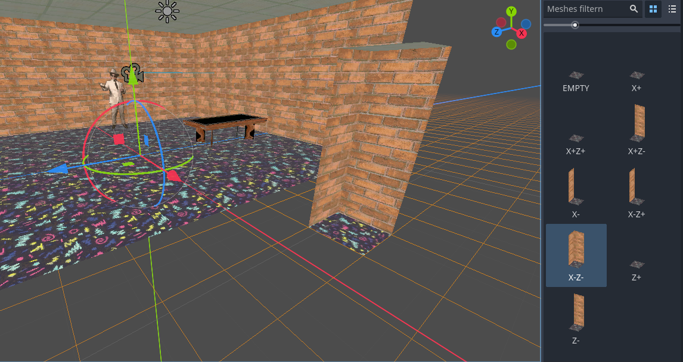
Gridmap

Slide 4
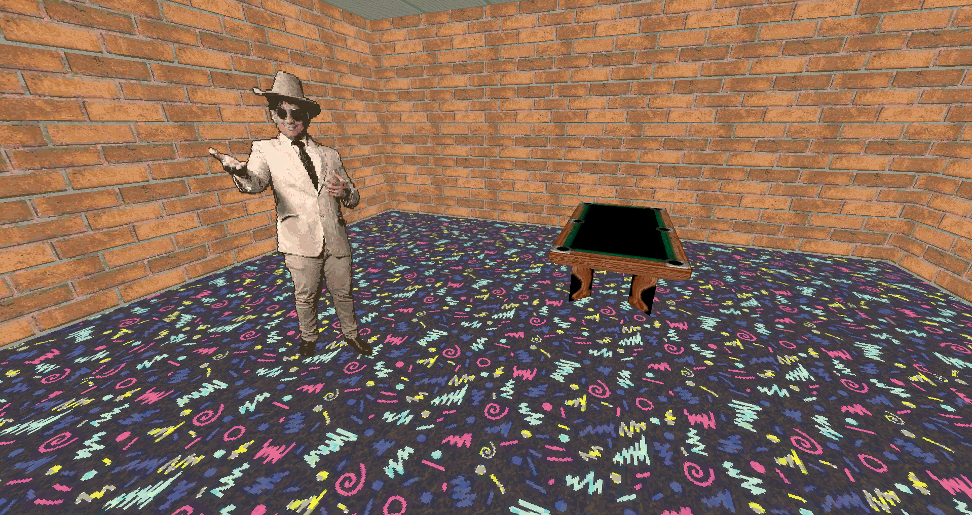
3D Environment

Slide 5
Ticket Shop:
Proof of Concept
One of the main purposes of the ticket shop is to bring out the real arcade experience of buying prizes with your hard-earned ticket.
Therefore, we would build/define an interface with this scenario as well as purchasing the prizes and tickets.
We would like to implement shop keep interaction and ability to see all the prizes and purchase those items in just one action.
We would define one main screen which is the shop itself, but a separate screen can be built for game developers.

Slide 6
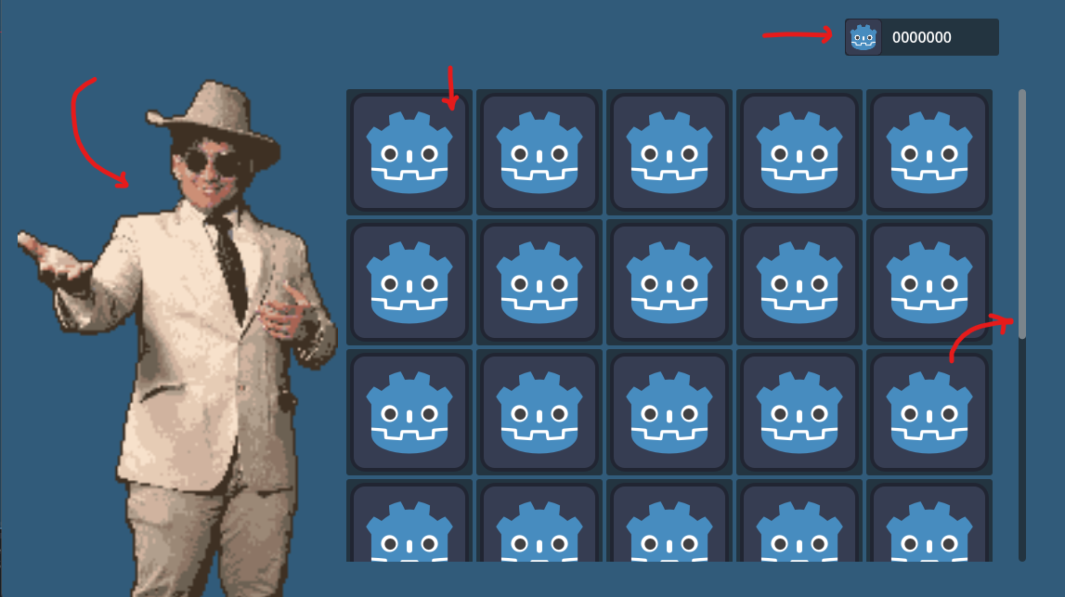
prizes
# of ticket
Shop keep
scroll to view more

Slide 7
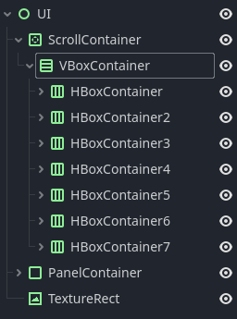
Prototype
Godot supports User Interface
This prototype is implemented with a separate vertical and horizontal container to populate the items in the shop.
This will become an issue when more items are put inside the shop.
For the final shop, we would implement more of grid box, that expands on its own depends on the number of items.

Slide 8
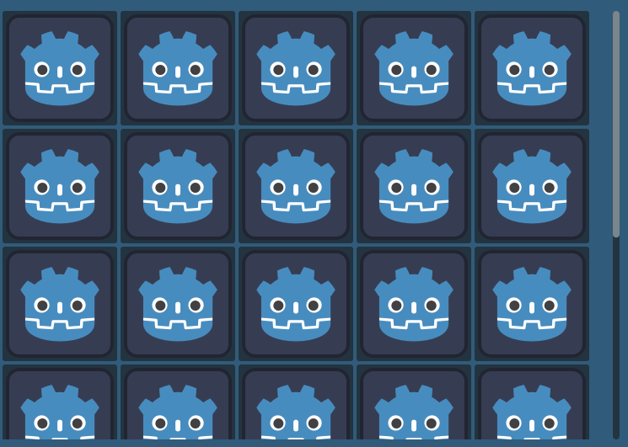
Final ticket shop
Would touch more on the implementation of the Tetris game, where blocks are populated inside the 2D game grid.
Define the shop grid with 5 columns (prizes icon in the same sizes) and a row integer that doubles when row capacity is reached.
Defining shop cells as grid slots with piece position, create an add item node to the grid and set up the position logic.

Slide 9
Communication Loop And Importing Arcade Games

Slide 10
Importing Arcade Games
2 libraries both with limited functionality FileAccess or DirAccess
2D arrays are difficult to use in godot, dictionaries worked better
DirAccess File cleanup

Slide 11
COmmunication Loop
Launches in a blocking way all on one thread
Takes time to load program
Registers all clicks while launching new program

Slide 12
Arcade Layout Generation
The Arcade Layout will be generated like an array below
Such generation can be modular and simply increasing the number of columns
The algorithm we use is on the next slide where for each arcade box we have more column generation
[+,+][+, ][+, ][+, ][+,+]
[ ,-][A,A][ , ][A,A][ ,+]
[ ,-][ , ][ , ][ , ][ ,+]
[-,-][-, ][-, ][-, ][-,+]

Slide 13
Layout Generation
# Calculate width based on the number of arcade machines with spacing
width = num_machines * 2 + 2
height = 5
# Initialize hallway layout with empty cells with no orientation
hallway = [[Cell(NONE) for _ in range(width)] for _ in range(height)]
Above is some pseudocode to generate the arcade layout

Slide 14
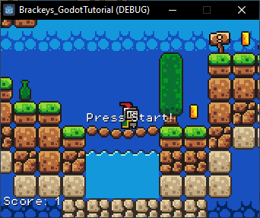
Cabinet visuals Proof of Concept: Technical Challenges
Implementation of VideoStreamPlayer in Godot
  Lack of built in functionality (no downscaling, video seeking, directional audio)
  Only supports ogg/ogv video format
Creating a process for obtaining optimized video previews in ogv format.
  Recording in OBS in mp4 format, what are the best settings?
  Best methods to convert? Ideal FPS? Ideal Resolution?
  What is our size limit? (2mb arbitrarily) How long of a preview does that give?
Preview video itself: Customizable UI for flashing "Press Start!" Or "Insert Coin!"
Need a cabinet to put the preview on! (solidifies aspect ratio and scale)

Slide 15
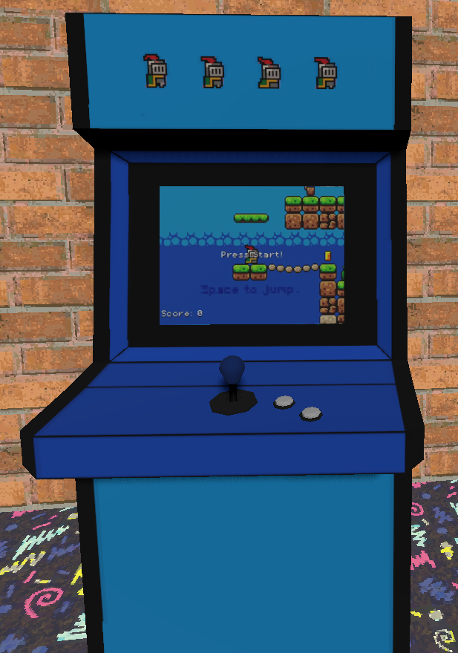
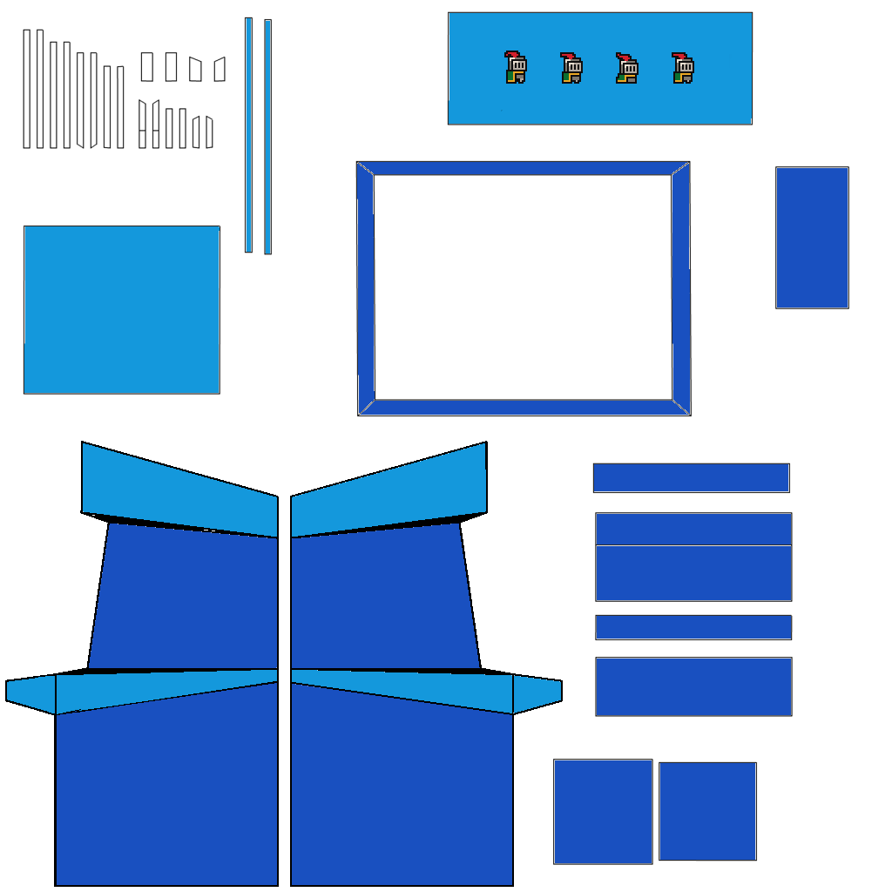
Cabinet visuals Proof of Concept:
Cabinet Model
Started by searching for low poly arcade cabinets asset w/ UV maps.
  Solidifies what aspect ratio and scale I made video previews in. (4:3 - 340x255p)
Found free pack on Itch.io by aurynsky called "Arcade Machines Lowpoly 3D Assets" that fit requirements
  Easily modifiable UV template.
  Low poly
  Bonus: has separate buttons, coin inserts and panels in pack

Slide 16
Cabinet visuals Proof of Concept:
Recording/Conversion Process
Godot project settings -> Display -> Window: select 4:3 ratio (340x255 in my case).
Make sure Godot is running at a high physics ticks per Second (and FPS) to reduce blur.
Recording in OBS: (10-15fps, same ratio) exporting as mp4 format.
Converting mp4 to ogg file format in VLC, (340x255, x2 scale, 800bitrate,10fps)
VideoStreamPlayer Implementation:
VideoStreamPlayer relatively simple to implement, casts viewport onto a flat plane mesh.
  With this setup, can play any ogg/ogv video given to VideoStreamPlayer.
However, audio played from the VideoStreamPlayer node plays globally
  Need to create a function that controls volume based on player location and cabinet location
  Functions measurement can also then be used for shutting off/pausing videos

Slide 17
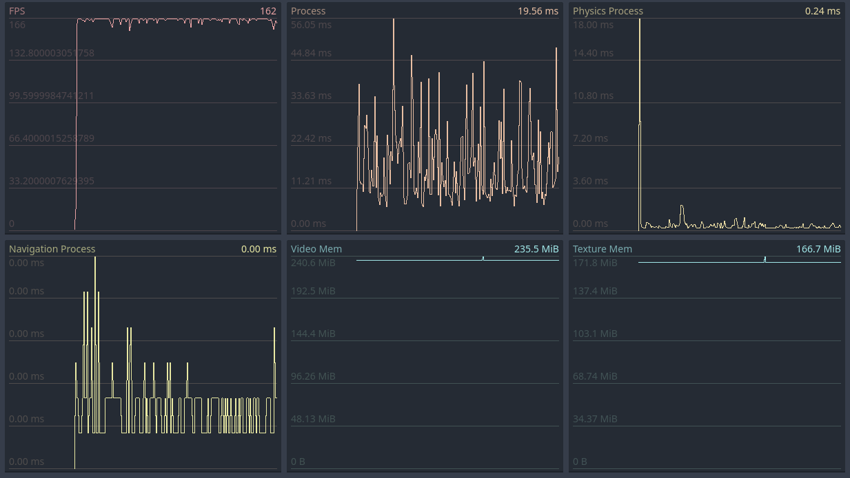
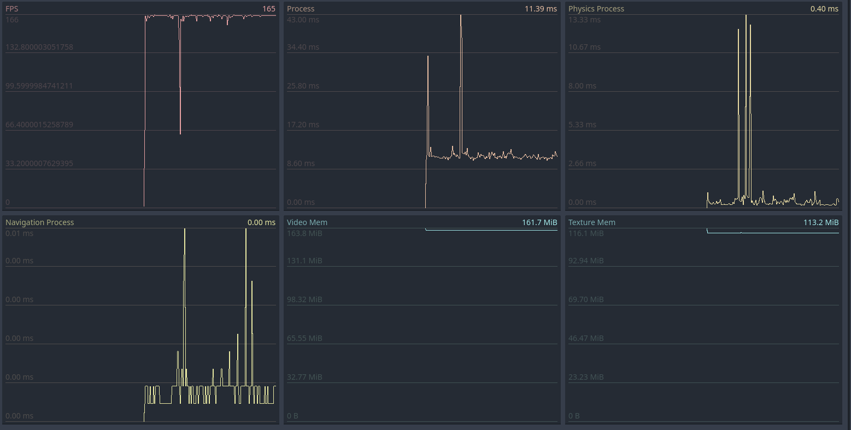
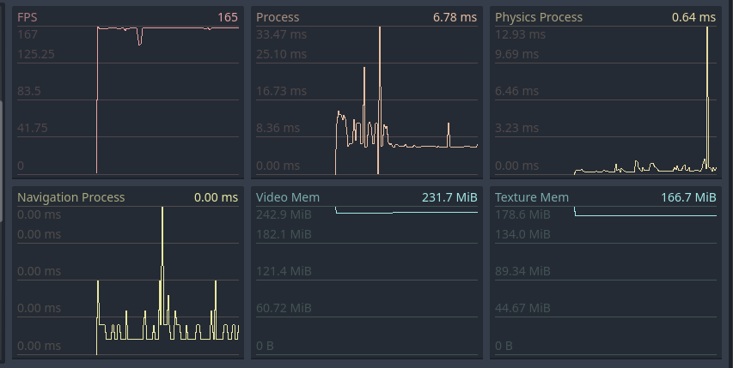
Cabinet visuals Proof of Concept:
VIdeoStreamPlayer Initial Testing
To verify the validity of this implementation, basic testing was done.
Performance seems okay at a glance...
10 video playing
1 video playing
10 non-video playing

Slide 18
